Slide 1

Dynamic Programming
Efficient Problem Solving Through Optimal Substructure
Anuska Nath | 002311001003
Information Technology - UG3

Slide 2
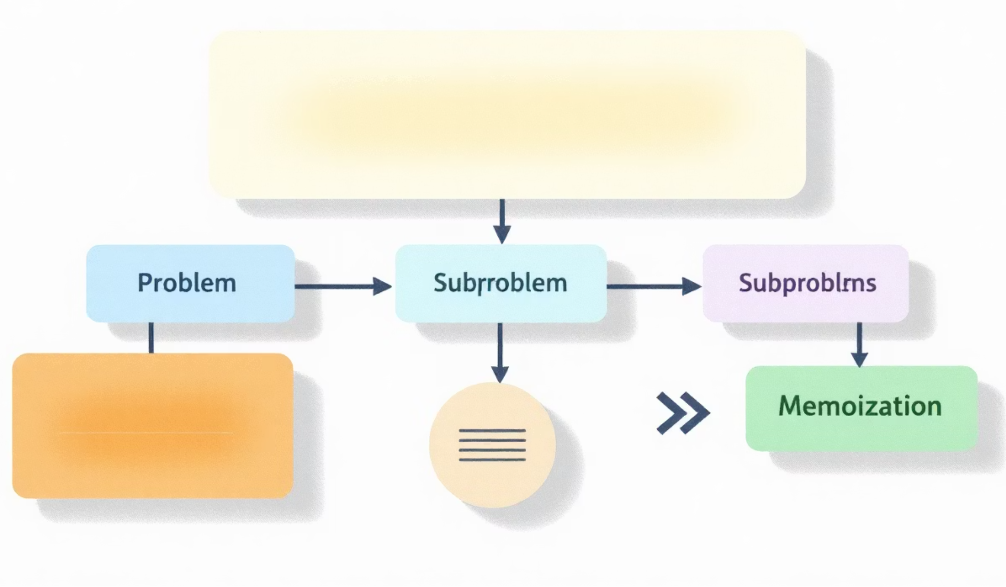
What is Dynamic Programming?
Dynamic Programming solves problems by storing solutions of smaller subproblems and reusing them.
Dynamic Programming (DP) is a powerful algorithmic technique that solves complex problems by breaking them into simpler overlapping subproblems. It stores solutions to subproblems to avoid redundant computations, dramatically improving efficiency.
Key characteristics: optimal substructure (optimal solution contains optimal solutions to subproblems) and overlapping subproblems (same subproblems solved multiple times).

Slide 3


Two Approaches to DP
Top-Down (Memoization)
Bottom-Up (Tabulation)
Solve problem recursively, storing results of subproblems in a cache. Check cache before computing to avoid redundant work.
Build solutions iteratively from smallest subproblems to the final solution. Fill table systematically.
Space efficient
No recursion overhead
Iterative approach
Intuitive and natural
Lazy evaluation
Uses recursion

Slide 4

Fibonacci Series: The Classic Example
The Fibonacci sequence demonstrates DP beautifully—each number is the sum of the two preceding ones: F(n) = F(n-1) + F(n-2).
01
02
Naive Recursive Approach
DP with Memoization
O(2^n) time complexity—exponential growth with massive redundancy in calculations.
O(n) time, O(n) space—store computed values, eliminate redundant recursive calls.
03
Optimized Tabulation
O(n) time, O(1) space—iterative solution using only two variables to track previous values.

Slide 5
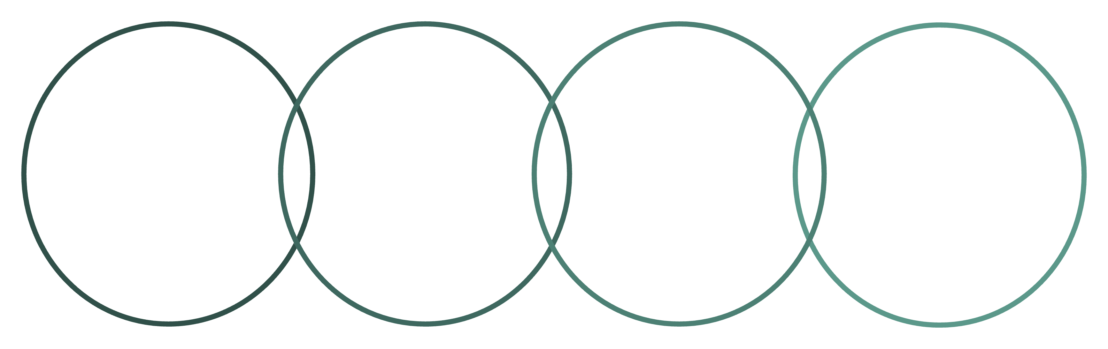
Visualizing Fibonacci with DP
Without DP
With DP
Tree diagram shows exponential growth of redundant recursive calls. Same subproblems calculated repeatedly.
Linear path shows efficient computation. Each subproblem solved exactly once and stored for future reference.
Overlapping Subproblems
Recursion Tree
Linear DP
Memoization
Exponential redundant calls
Each subproblem computed once
Stores results for reuse
Same nodes recomputed often
The dramatic difference in computational efficiency is immediately apparent when visualizing both approaches side by side.

Slide 6

The Knapsack Problem
Given a knapsack with capacity W and n items, each with weight wᵢ and value vᵢ, maximize total value without exceeding weight capacity.
Decision at Each Item
Include or exclude current item based on which choice yields higher value
State Definition
DP[i][w] = maximum value using first i items with weight limit w

Slide 7



Knapsack: Building the Solution
Initialize Base Cases
DP[0][w] = 0 for all w (no items means zero value)
Iterate Through Items
For each item, consider both inclusion and exclusion scenarios
Apply Recurrence Relation
DP[i][w] = max(DP[i-1][w], DP[i-1][w-wᵢ] + vᵢ)
DP[i-1][w] → item not included
DP[i-1][w-wi] + vi → item included
Extract Final Answer
DP[n][W] contains maximum achievable value

Slide 8
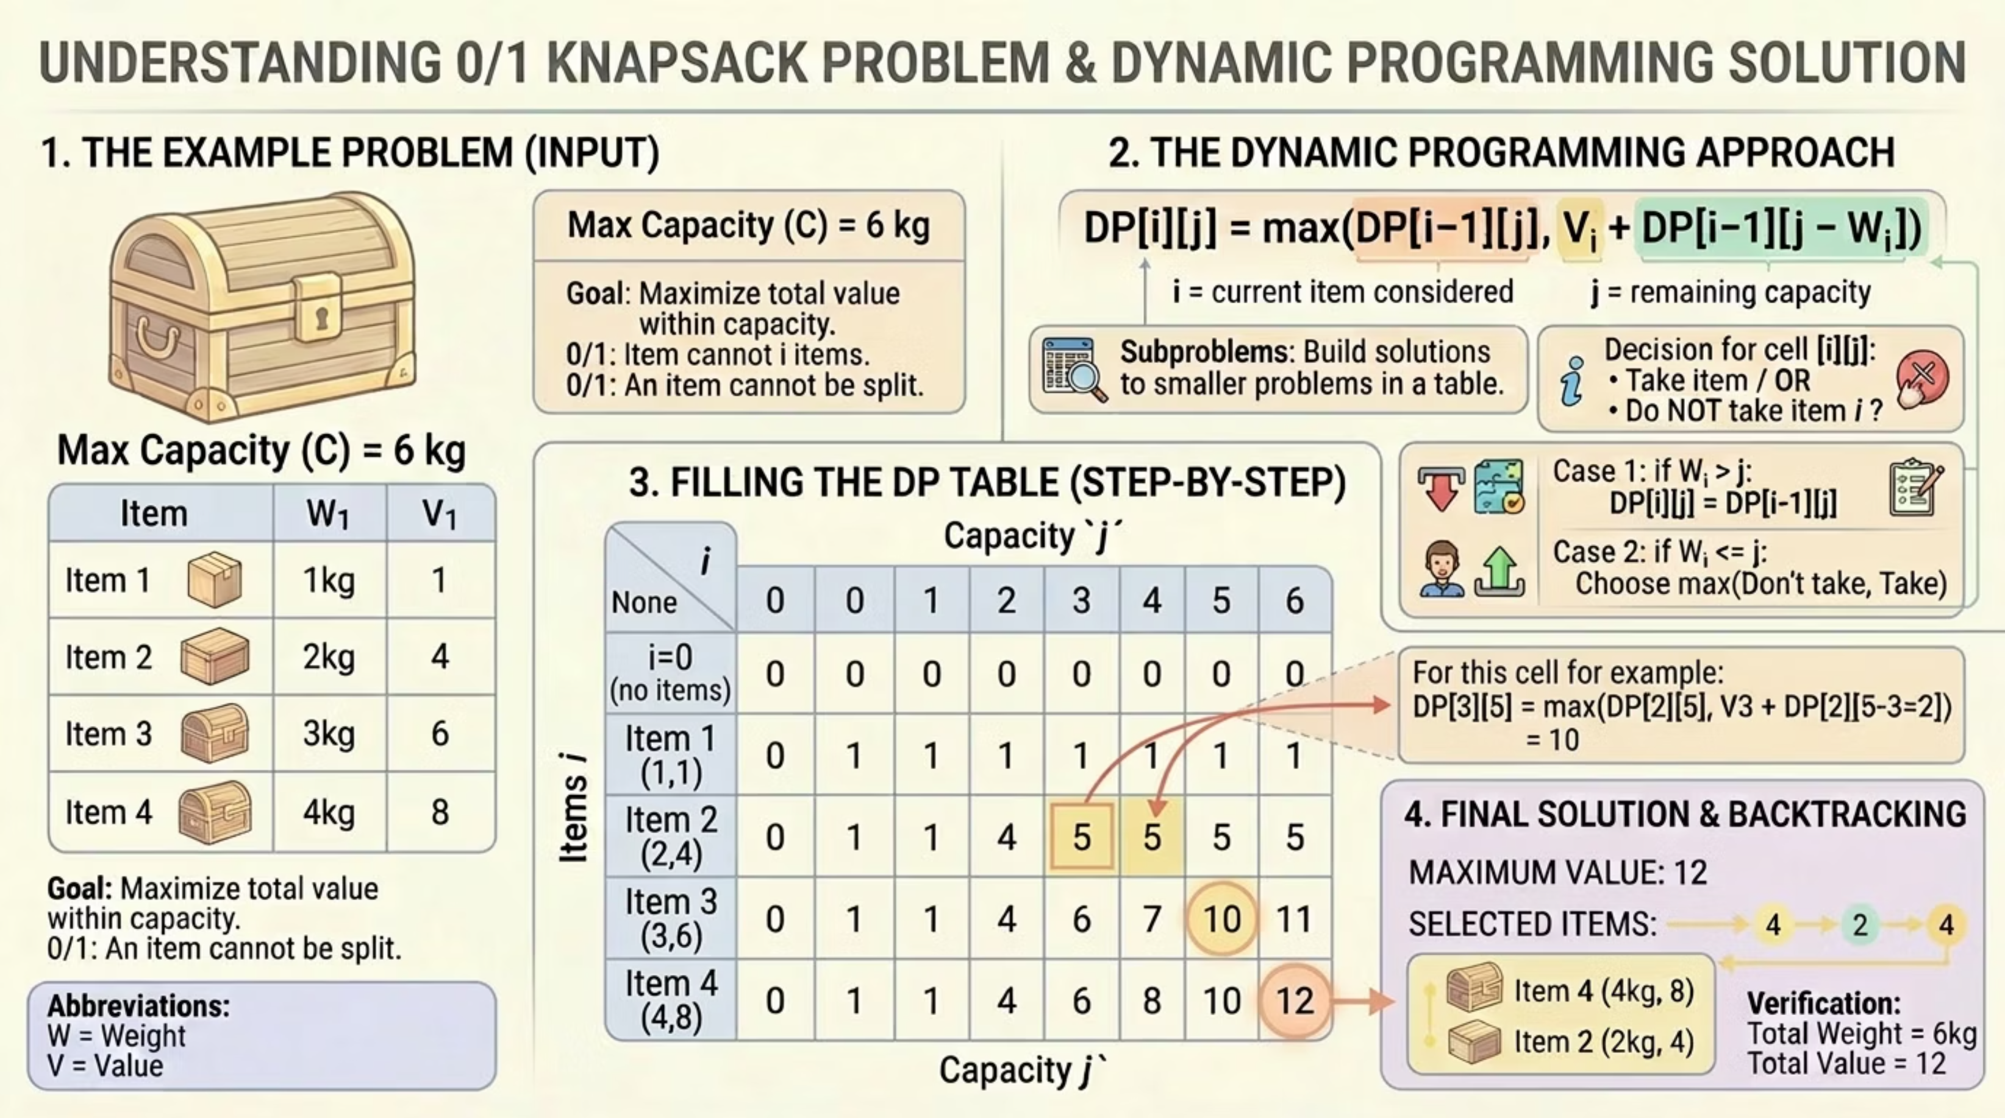

Slide 9

Complexity Analysis
O(nW)
O(nW)
O(W)
Time Complexity
Space Complexity
Optimized Space
n items × W capacity states
2D table storing all states
1D array using only previous row
Key Insight: Pseudo-polynomial time—efficient when W is reasonable but becomes impractical for large capacities.

Slide 10




Real-World Applications
Resource Allocation
Operations Research
Optimize budget distribution across projects, investment portfolio management, and capital budgeting decisions.
Solve cutting stock problems, cargo loading optimization, and production scheduling in manufacturing.
Bioinformatics
Game Development
Sequence alignment, protein folding prediction, and genetic sequence analysis algorithms.
AI decision trees, pathfinding optimization, and resource management in strategy games.

Slide 11

Key Takeaways
Store, Don't Recompute
Memoization eliminates redundant calculations by caching subproblem solutions
Build Bottom-Up
Iterative tabulation often more efficient than recursive memoization
Recognize Patterns
Optimal substructure and overlapping subproblems signal DP applicability

